Slide 1
SORTING ALGORITHMS

Slide 2
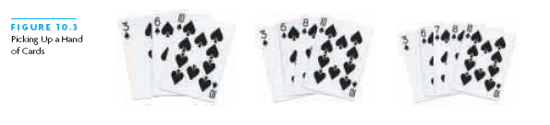
Insertion Sort
Based on technique of card players to arrange a hand
Player keeps cards picked up so far in sorted order
When the player picks up a new card
Makes room for the new card
Then inserts it in its proper place

Slide 3
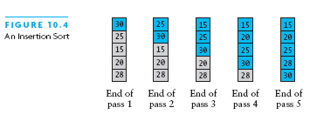
Insertion Sort

Slide 4
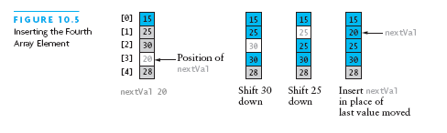
Insertion Sort

Slide 5
Implementing Insertion Sort
public static <T extends Comparable<T>> void sort (T[] a) {
for (int nextPos = 1; nextPos < a.length; nextPos++) {
T nextVal = a[nextPos];
while(nextPos > 0 && nextVal.compareTo(a[nextPos-1]) < 0){
a[nextPos] = a[nextPos-1];
nextPos--;
}
a[nextPos] = nextVal;
}
}

Slide 6
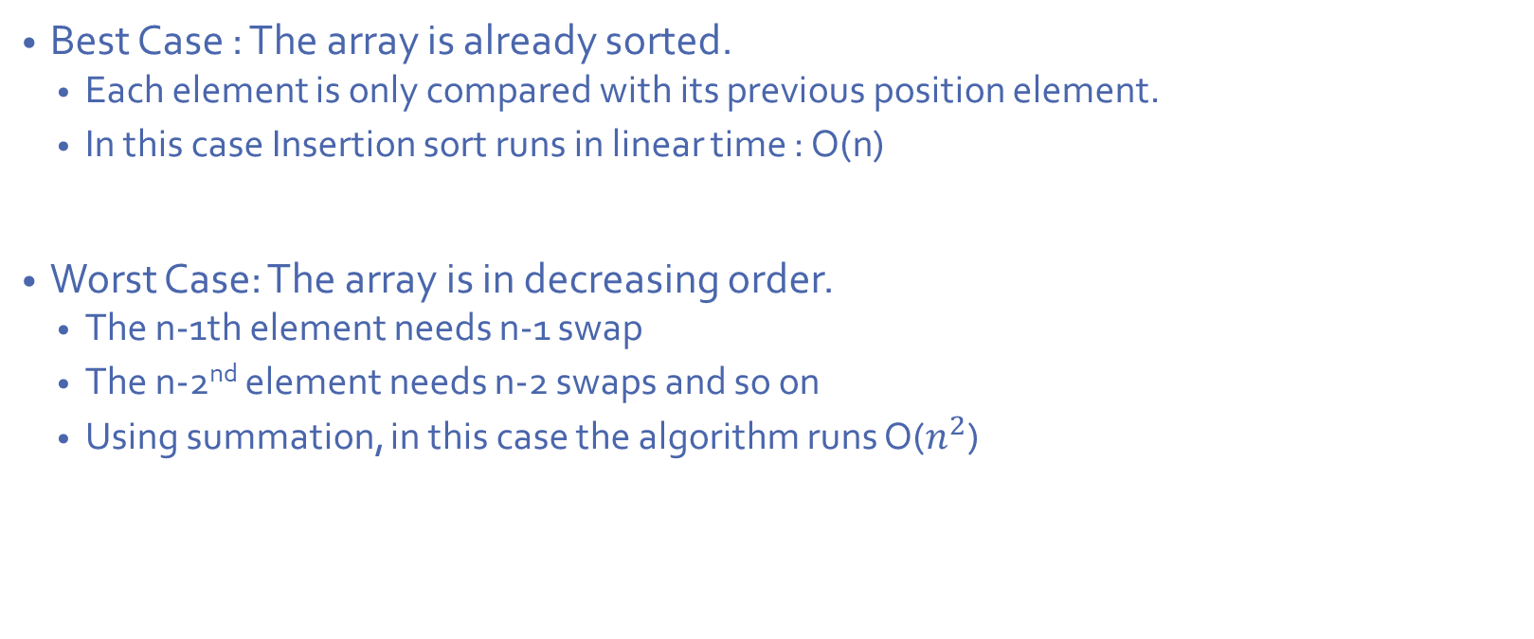
Analysis of Insertion Sort
Best Case : The array is already sorted.
Each element is only compared with its previous position element.
In this case Insertion sort runs in linear time : O(n)
Worst Case: The array is in decreasing order.
The n-1th element needs n-1 swap
The n-2nd element needs n-2 swaps and so on
Using summation, in this case the algorithm runs O($n^{2}$)

Slide 7
Shell Sort
Named after Donald Shell.
Problem with Insertion sort :
We have to move many items in the sorted part of the array to insert a new element.
The problem arises when we have to move a smaller element from the back of the array to the first.
Divide and conquer approach to insertion sort
Sort many smaller subarrays using insertion sort
Sort progressively larger arrays
Finally sort the entire array
Shell sort works by comparing elements that are distant rather than adjacent.
These arrays are elements separated by a gap
Start with large gap
Decrease the gap on each “pass”

Slide 8
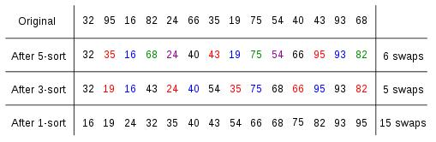
Shell Sort

Slide 9
Shell Sort – Code
public static <T extends Comparable<T>> void sort (T[] a) {
int j;
for(int gap = a.length/2; gap>0; gap/=2){
for(int i=gap; i<a.length; i++){
T temp = a[i];
for(j=i; j>=gap && temp.compareTo(a[j-gap])<0; j-=gap){
a[j]=a[j-gap];
a[j]=temp;
}
}

Slide 10
Shell Sort - Analysis
Its general analysis is an open research problem
Performance depends on sequence of gap values
For sequence 2^{k}, performance is O(n²)
Hibbard’s sequence (2^{k}-1), performance is O(n^{3/2})
Knuth’s sequence, performance is O(n^{3/2})
For Shell sort, the running time is dependent on number of increments and their values.
Shell sort is Unstable and an In-place Sort

Slide 11
Shell Sort - Analysis
Elements move long distances at a time, elements move to its final place quicker.
Insertion sort is efficient :
When list is small
When list is almost sorted
When increments are large – Size of the sublists are smaller
When increments are small – Sublists are large, but they are almost sorted.

Slide 12
Shell Sort – Choosing Increments
}
Shell’s suggestion :
arrayLength/2 initially then decrementing by 2 every pass
The elements at the odd places and even places are not compared until the last pass.
Increments that are multiples are each other 1,3,6,9 1,2,4,8
In this case the same elements get compared over and over again till the last pass.
Increments that are relatively prime are a good choice
Knuth Sequence : h= 3*h + 1
int h = 1; while (h < numbers.length / 3) h = 3 * h + 1;
Decrement : h=(h-1)/3

Slide 13
QuickSort
Quicksort uses a divide and conquer strategy, but does not require the O(N) extra space that MergeSort does
Partition array into left and right sub-arrays
Choose an element of the array, called pivot
the elements in left sub-array are all less than pivot
elements in right sub-array are all greater than pivot
Recursively sort left and right sub-arrays
Concatenate left and right sub-arrays in O(1) time

Slide 14
Quicksort - Steps
To sort an array A
1. If the number of elements in A is 0 or 1, then return. The array is sorted.
2. Pick an element p in A. This is the pivot value.
3. Partition A-{p} into two disjoint subsets, A₁ = {all values x≤p}, and A₂ = {all values x≥p}.
4. Return QuickSort(A₁), p, QuickSort(A₂)

Slide 15
Quicksort - Partitioning
Partition the array into left and right sub-arrays
left sub-array -> elements ≤ pivot
right sub-array are -> elements ≥ pivot
Getting the elements to the correct sub-array:
Choose an element from the array as the pivot
Make one pass through the rest of the array and swap as needed to put elements in partitions

Slide 16
In-place partitioning
References front and back to start and end of array
Increment front until -> A[front] > pivot
Decrement back until -> A[back] < pivot
Swap A[front] and A[back]
Repeat until front and back cross
Swap pivot with A[back]

Slide 17
lowIndex = 0
upIndex = 8
pivotIndex = 0
40
20
10
80
60
50
7
30
100
[0] [1] [2] [3] [4] [5] [6] [7] [8]
i
j

Slide 18
While array[i] <= array[pivotIndex]
++i;
pivotIndex = 0
40
20
10
80
60
50
7
30
100
[0] [1] [2] [3] [4] [5] [6] [7] [8]
i
j

Slide 19
While array[i] <= array[pivotIndex]
++i
pivotIndex = 0
40
20
10
80
60
50
7
30
100
[0] [1] [2] [3] [4] [5] [6] [7] [8]
i
j

Slide 20
While array[i] <= array[pivotIndex]
++i
pivotIndex = 0
40
20
10
80
60
50
7
30
100
[0] [1] [2] [3] [4] [5] [6] [7] [8]
i
j

Slide 21
While array[i] <= array[pivotIndex]
++i
While array[j] > array[pivotIndex]
--j
pivotIndex = 0
40
20
10
80
60
50
7
30
100
[0] [1] [2] [3] [4] [5] [6] [7] [8]
i
j

Slide 22
While array[i] <= array[pivotIndex]
++i
While array[j] > array[pivotIndex]
--j
pivotIndex = 0
40
20
10
80
60
50
7
30
100
[0] [1] [2] [3] [4] [5] [6] [7] [8]
i
j

Slide 23
While array[i] <= array[pivotIndex]
++i
While array[j] > array[pivotIndex]
--j
If i < j
swap array[i] and array[j]
pivotIndex = 0
40
20
10
80
60
50
7
30
100
[0] [1] [2] [3] [4] [5] [6] [7] [8]
i
j

Slide 24
While array[i] <= array[pivotIndex]
++i
While array[j] > array[pivotIndex]
--j
If i < j
swap array[i] and array[j]
pivotIndex = 0
40
20
10
30
60
50
7
80
100
[0] [1] [2] [3] [4] [5] [6] [7] [8]
i
j

Slide 25
While array[i] <= array[pivotIndex]
++i
While array[j] > array[pivotIndex]
--j
If i < j
swap array[i] and array[j]
While j > i, go to 1.
pivotIndex = 0
40
20
10
30
60
50
7
80
100
[0] [1] [2] [3] [4] [5] [6] [7] [8]
i
j

Slide 26
While array[i] <= array[pivotIndex]
++i
While array[j] > array[pivotIndex]
--j
If i < j
swap array[i] and array[j]
While j > i, go to 1.
pivotIndex = 0
40
20
10
30
60
50
7
80
100
[0] [1] [2] [3] [4] [5] [6] [7] [8]
i
j

Slide 27
While array[i] <= array[pivotIndex]
++i
While array[j] > array[pivotIndex]
--j
If i < j
swap array[i] and array[j]
While j > i, go to 1.
pivotIndex = 0
40
20
10
30
60
50
7
80
100
[0] [1] [2] [3] [4] [5] [6] [7] [8]
i
j

Slide 28
While array[i] <= array[pivotIndex]
++i
While array[j] > array[pivotIndex]
--j
If i < j
swap array[i] and array[j]
While j > i, go to 1.
pivotIndex = 0
40
20
10
30
60
50
7
80
100
[0] [1] [2] [3] [4] [5] [6] [7] [8]
i
j

Slide 29
While array[i] <= array[pivotIndex]
++i
While array[j] > array[pivotIndex]
--j
If i < j
swap array[i] and array[j]
While j > i, go to 1.
pivotIndex = 0
40
20
10
30
60
50
7
80
100
[0] [1] [2] [3] [4] [5] [6] [7] [8]
i
j

Slide 30
While array[i] <= array[pivotIndex]
++i
While array[j] > array[pivotIndex]
--j
If i < j
swap array[i] and array[j]
While j > i, go to 1.
pivotIndex = 0
40
20
10
30
60
50
7
80
100
[0] [1] [2] [3] [4] [5] [6] [7] [8]
i
j

Slide 31
While array[i] <= array[pivotIndex]
++i
While array[j] > array[pivotIndex]
--j
If i < j
swap array[i] and array[j]
While j > i, go to 1.
pivotIndex = 0
40
20
10
30
7
50
60
80
100
[0] [1] [2] [3] [4] [5] [6] [7] [8]
i
j

Slide 32
While array[i] <= array[pivotIndex]
++i
While array[j] > array[pivotIndex]
--j
If i < j
swap array[i] and array[j]
While j > i, go to 1.
pivotIndex = 0
40
20
10
30
7
50
60
80
100
[0] [1] [2] [3] [4] [5] [6] [7] [8]
i
j

Slide 33
While array[i] <= array[pivotIndex]
++i
While array[j] > array[pivotIndex]
--j
If i < j
swap array[i] and array[j]
While j > i, go to 1.
pivotIndex = 0
40
20
10
30
7
50
60
80
100
[0] [1] [2] [3] [4] [5] [6] [7] [8]
i
j

Slide 34
While array[i] <= array[pivotIndex]
++i
While array[j] > array[pivotIndex]
--j
If i < j
swap array[i] and array[j]
While j > i, go to 1.
pivotIndex = 0
40
20
10
30
7
50
60
80
100
[0] [1] [2] [3] [4] [5] [6] [7] [8]
i
j

Slide 35
While array[i] <= array[pivotIndex]
++i
While array[j] > array[pivotIndex]
--j
If i < j
swap array[i] and array[j]
While j > i, go to 1.
pivotIndex = 0
40
20
10
30
7
50
60
80
100
[0] [1] [2] [3] [4] [5] [6] [7] [8]
i
j

Slide 36
While array[i] <= array[pivotIndex]
++i
While array[j] > array[pivotIndex]
--j
If i < j
swap array[i] and array[j]
While j > i, go to 1.
pivotIndex = 0
40
20
10
30
7
50
60
80
100
[0] [1] [2] [3] [4] [5] [6] [7] [8]
i
j

Slide 37
While array[i] <= array[pivotIndex]
++i
While array[j] > array[pivotIndex]
--j
If i < j
swap array[i] and array[j]
While j > i, go to 1.
pivotIndex = 0
40
20
10
30
7
50
60
80
100
[0] [1] [2] [3] [4] [5] [6] [7] [8]
i
j

Slide 38
While array[i] <= array[pivotIndex]
++i
While array[j] > array[pivotIndex]
--j
If i < j
swap array[i] and array[j]
While j > i, go to 1.
pivotIndex = 0
40
20
10
30
7
50
60
80
100
[0] [1] [2] [3] [4] [5] [6] [7] [8]
i
j

Slide 39
While array[i] <= array[pivotIndex]
++i
While array[j] > array[pivotIndex]
--j
If i < j
swap array[i] and array[j]
While j > i, go to 1.
pivotIndex = 0
40
20
10
30
7
50
60
80
100
[0] [1] [2] [3] [4] [5] [6] [7] [8]
i
j

Slide 40
While array[i] <= array[pivotIndex]
++i
While array[j] > array[pivotIndex]
--j
If i < j
swap array[i] and array[j]
While j > i, go to 1.
Swap array[j] and data[pivotIndex]
pivotIndex = 0
40
20
10
30
7
50
60
80
100
[0] [1] [2] [3] [4] [5] [6] [7] [8]
i
j

Slide 41
While array[i] <= array[pivotIndex]
++i
While array[j] > array[pivotIndex]
--j
If i < j
swap array[i] and array[j]
While j > i, go to 1.
Swap array[j] and data[pivotIndex]
7
20
10
30
40
50
60
80
100
pivotIndex = 4
[0] [1] [2] [3] [4] [5] [6] [7] [8]
i
j

Slide 42
Partition Result
7
20
10
30
40
50
60
80
100
[0] [1] [2] [3] [4] [5] [6] [7] [8]
<= array[pivotIndex]
> array[pivotIndex]

Slide 43
Recursion: Quicksort Sub-arrays
7
20
10
30
40
50
60
80
100
[0] [1] [2] [3] [4] [5] [6] [7] [8]
<= array[pivotIndex]
> array[pivotIndex]

Slide 44
Analysis of Quicksort – Best Case
For each sub array pivot is place approximately in the middle of the array.
Array size n -> 2 subarrays ~ n/2 -> 4 subarrays ~ n/4 -> 8 subarrays ~ n/8
n subarrays of size 1
n elements are repeatedly dived in half approximately log₂n times
After splitting the array log₂n times we get n subarrays of size 1
Depth of recursion : O(logn)
Number of accesses in partition : O(n)
=>O( n logn )

Slide 45
Analysis of Quicksort – Worst Case
If Pivot is the smallest or largest element of the list
One empty subarray and other has n-1 elements
Worst case is when this happens for every subarray
If the first element is pivot :
This worse case occurs when the list is already sorted / is in descending order.

Slide 46
Worst Case - contd
Recursion:
Partition splits array in two sub-arrays:
one sub-array of size 0
the other sub-array of size n-1
Quicksort each sub-array
Depth of recursion : O(n)
Number of accesses in partition : O(n)
=>O( n²)
Quicksort is unstable and In-place

Slide 47
Merge Sort
Divide the list into two subarrays of almost equal size
Sort the left subarray using merge sort
Sort the right subarray using merge sort
Merge the two sorted subarrays, in the order of splitting
Terminating condition for recursion – subarray contains ony one element

Slide 48
Merge Sort - Example
8
2
9
4
5
3
1
6
Divide
8 2 9 4
5 3 1 6
Divide
8 2
9 4
5 3
1 6
Divide
8 2 9 4 5 3 1 6
Merge
2 8 4 9 3 5 1 6
Merge
2 4 8 9 1 3 5 6
Merge
1 2 3 4 5 6 8 9

Slide 49
Merge Sort – Indexes
0
10
0
5
6
10
0
2
3
5
6
8
9
10
0
1
2
2
3
4
5
5
6
7
8
8
9
9
10
10
0
0
1
1
3
3
4
5
6
6
7
7

Slide 50
Analysis of Merge Sort
N elements are repeatedly divided in half approximately log₂n times
After splitting the array log₂n times we get n sub arrays of size 1
In each pass -> We merge n elements hence -> O(n)
Therefore the performance of merge sort is O(nlogn) -> Best and Worst Case
Stable sort
Not an in-place sort -> Needs an auxiliary array to store n elements -> O(n)

Slide 51
Radix Sort
Sorting is performed digit by digit
Least significant digit -> most significant digit
Pass 1 : Units Place digit
Pass 2: Tens Place digit
…….
Last Pass : Most significant place digit

Slide 52
Radix Sort - Example
Input array: 126, 328, 636, 341, 416, 131, 328
Sort on lower digit: 341, 131, 126, 636, 416, 328, 328
Sort result on next-higher digit: 416, 126, 328, 328, 131, 636, 341
Sort that result on highest digit: 126, 131, 328, 328, 341, 416, 636

Slide 53
Implementation of Radix Sort
Input data is taken in a LinkedList
Sorting queues are also implemented as Linked Lists
Arrays increase space complexity – size of each queue will be n –> 10*n spaces
For each pass:
Insert nodes into different Queues – Rearrange Links
Combine queues back to main list – Rearrange Links

Slide 54
Analysis of Radix Sort
Every pass in Radix Sort has n operations ~ n
Depending on the number of digits (d) in the largest number , the complexity changes
Radix Sort is O(n*d)
If d is n -> O(n²)
if d is logn -> O(nlogn)
Radix Sort is not in-place and Stable

Slide 55
Heap Sort
Heaps Recap:
Binary tree
Balanced
Left-justified or Complete
(Max) Heap property: no node has a value greater than the value in its parent

Slide 56
Steps to Heap Sort
Build a Binary Tree
Heapify the Binary Tree
Extract Largest element
Maintain the heap (Downheap)
Determining location of root and “last node” take constant time
Remove n elements, re-heap each time

Slide 57
Building a Heap
8
8
10
10
10
8
8
5
1
2
3
10
10
12
8
5
12
5
10
5
12
8
8
4

Slide 58
12
12
14
10
5
14
5
12
5
8
14
8
10
8
10
Building Heap / Heapifying a Binary Tree does not mean the array is sorted.

Slide 59
Here’s a sample binary tree after it has been heapified
25
22
17
Any node i
Parent : i/2
Left child: 2*i
Right Child: 2*i + 1
19
22
14
15
18
14
21
3
9
11
Array = [25,22,17,19,22,14,15,18,14,21,3,9,11]

Slide 60
Notice that the largest number is now in the root
We discard the root:
11
22
17
19
22
14
15
18
14
21
3
9
11
How can we fix the binary tree so it is once again balanced and left-justified?
Solution: remove the rightmost leaf at the deepest level and use it for the new root

Slide 61
Our tree is balanced and left-justified, but no longer a heap
However, only the root lacks the heap property
11
22
17
19
22
14
15
18
14
21
3
9
We can downHeap() the root

Slide 62
Now the left child of the root (still the number 11) lacks the heap property
22
11
17
19
22
14
15
18
14
21
3
9
We can downHeap() this node

Slide 63
Now the right child of the left child of the root (still the number 11) lacks the heap property:
22
22
17
19
11
14
15
18
14
21
3
9
We can downHeap() this node

Slide 64
Our tree is once again a heap, because every node in it has the heap property
22
22
17
19
21
14
15
18
14
11
3
9
Once again, the largest (or a largest) value is in the root
We can repeat this process until the tree becomes empty
This produces a sequence of values in order largest to smallest

Slide 65
Analysis of Heap Sort
Traversing the Heap is O(log n)
And we only do O(1) operations at each node – Removal of root is constant time.
Since we downHeap inside a while loop that we do n times, the total time for the while loop is n*O(log n), or O(n log n)
Building the heap O(n log n)
Remove and re-heap O(log n)
Do this n times O(n log n)
Total time O(n log n) + O(n log n) ~ O(nlogn)
Heap Sort is not stable and in-place

